Slide 1
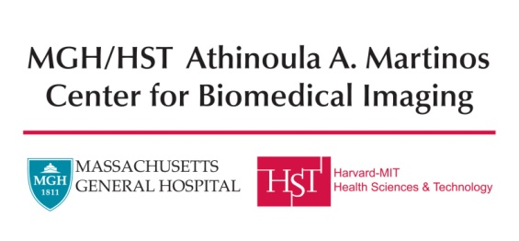


Input and Output Uncertainty in Medical Image Analysis
Koen Van Leemput
October 17, 2019
MICCAI UNSURE Workshop
Shenzhen, China

Slide 2
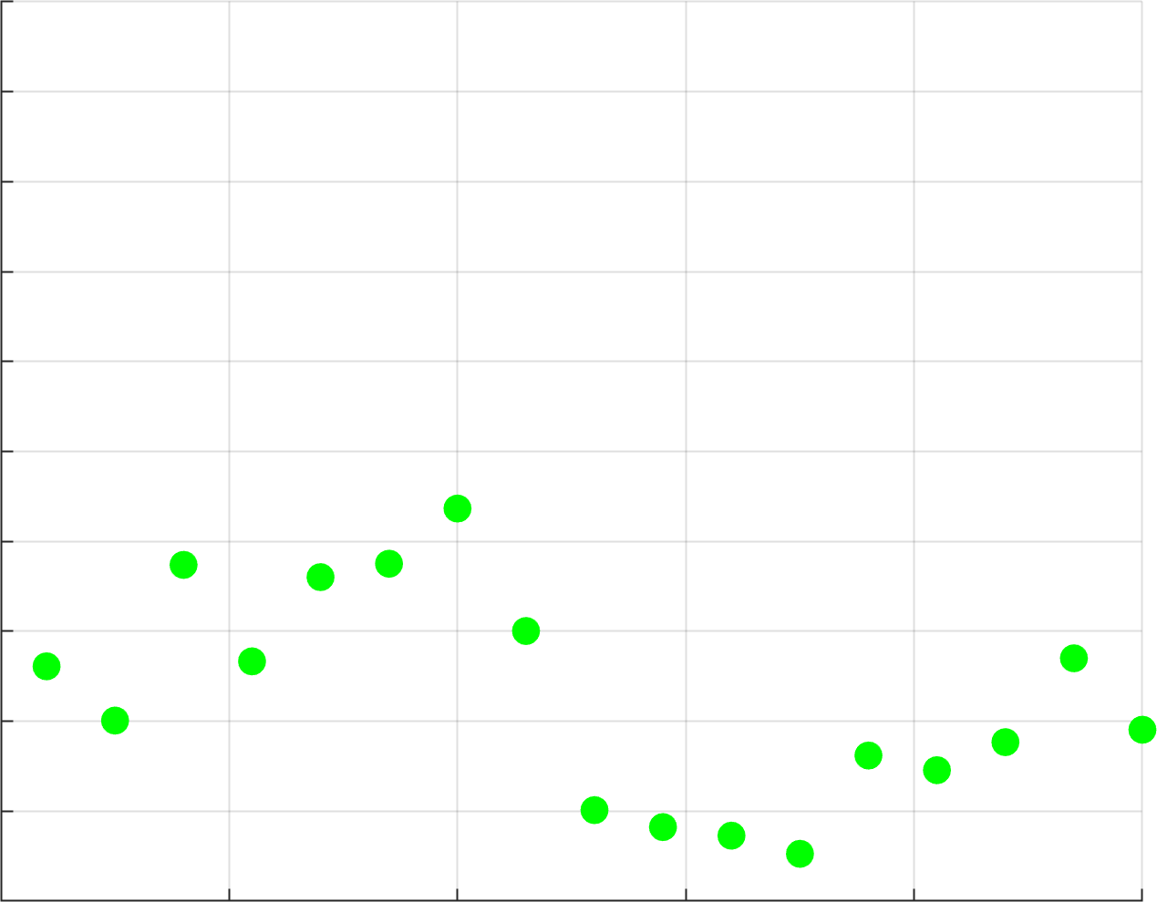
Uncertainty in input and output?
prediction
intensity

Slide 3
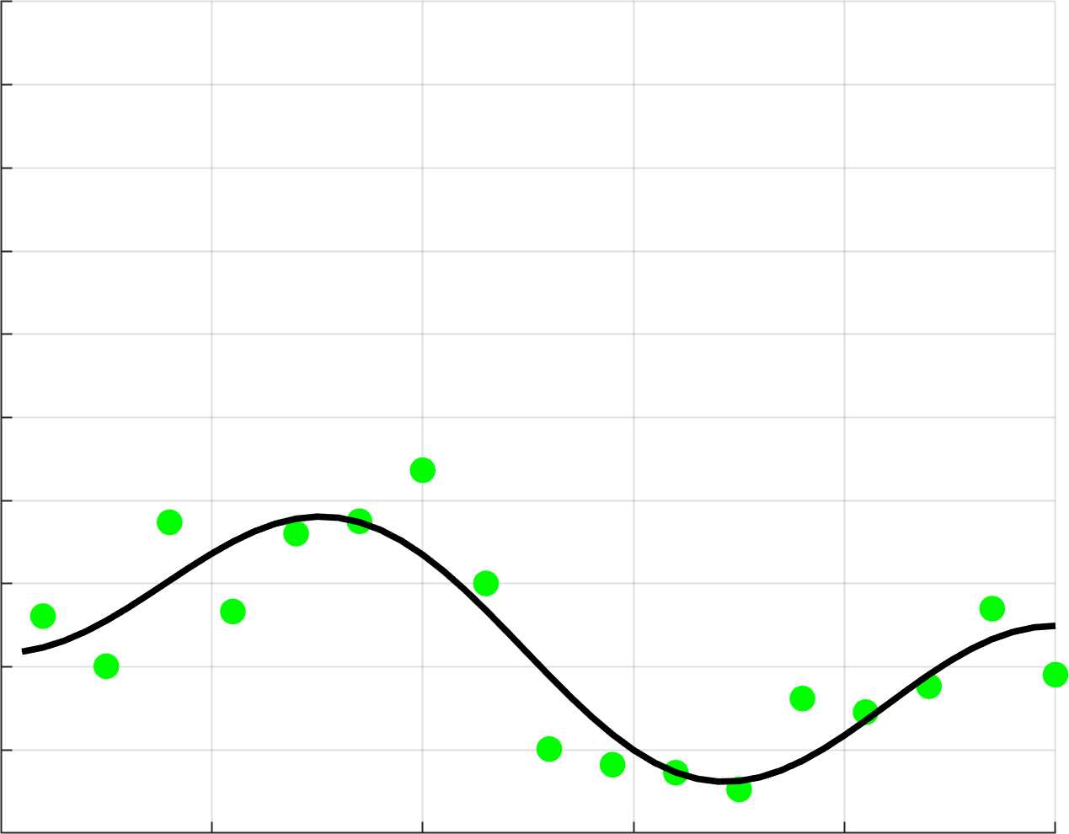
Uncertainty in input and output?
prediction
intensity

Slide 4
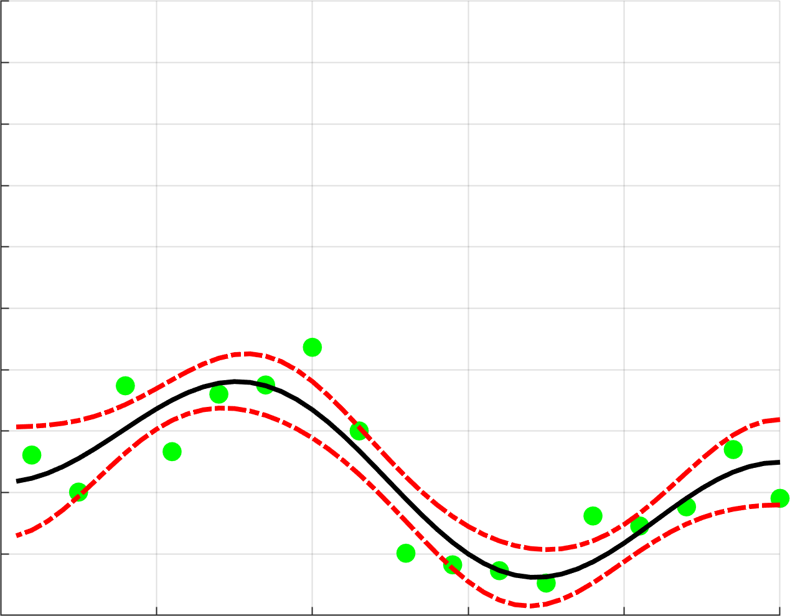
Uncertainty in input and output?
prediction
Uncertainty on output?
intensity

Slide 5
Uncertainty in input and output?
prediction
discriminative models:
CNNs + dropout at test time
Uncertainty on output?
intensity

Slide 6
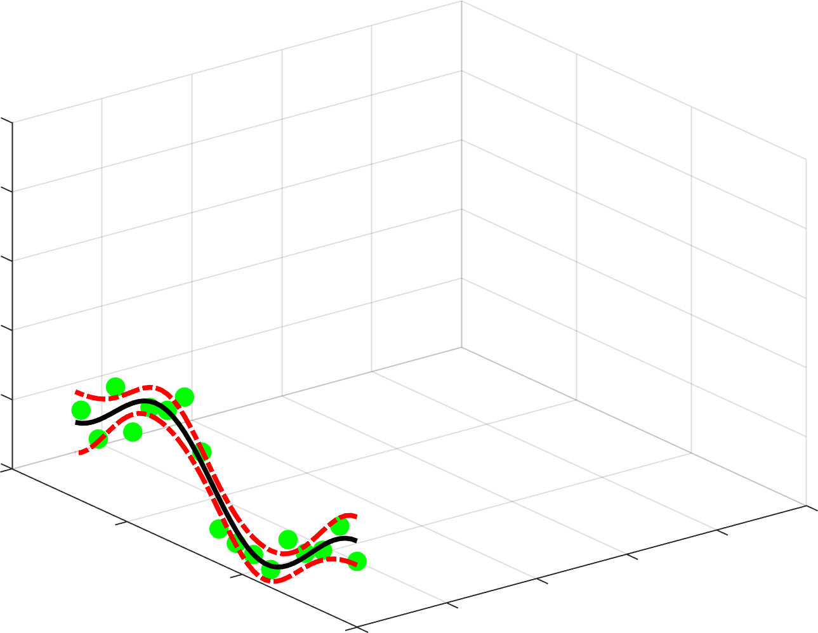
Uncertainty in input and output?
prediction
input variation
intensity

Slide 7
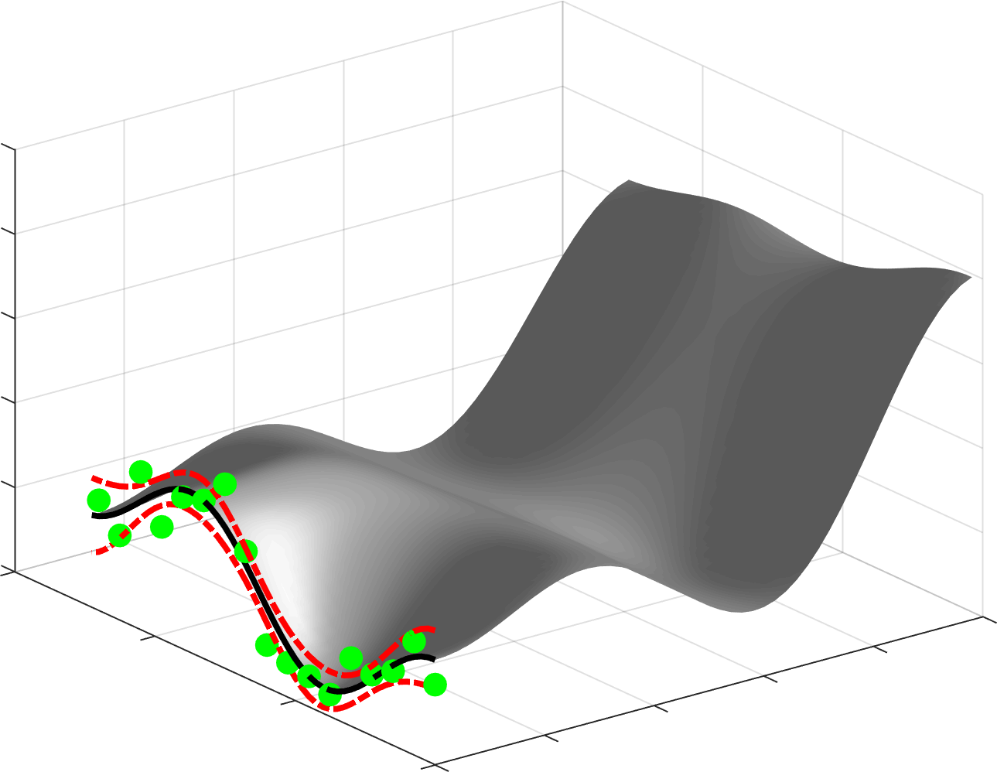
Uncertainty in input and output?
Uncertainty on input
prediction
- Imaging hardware?
- Imaging protocol?
- Contrast agent?
- Disease?
- Organ?
- ...?
input variation
intensity

Slide 8
Uncertainty in input and output?
Uncertainty on input
prediction
- Imaging hardware?
- Imaging protocol?
- Contrast agent?
- Disease?
- Organ?
- ...?
generative models:
MI registration,
N3 bias field corr., EM segmentation,
…
input variation
intensity

Slide 9
Overview
Uncertainty on input using generative models
Uncertainty on output using Monte Carlo sampling
Discussion and conclusion

Slide 10
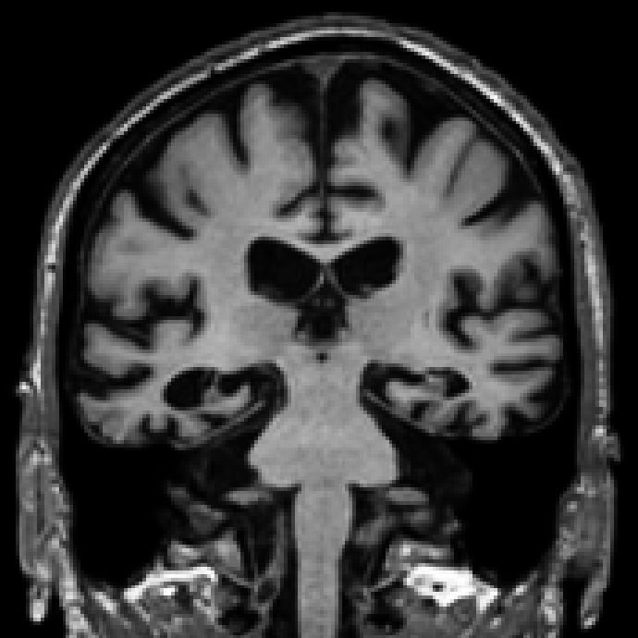
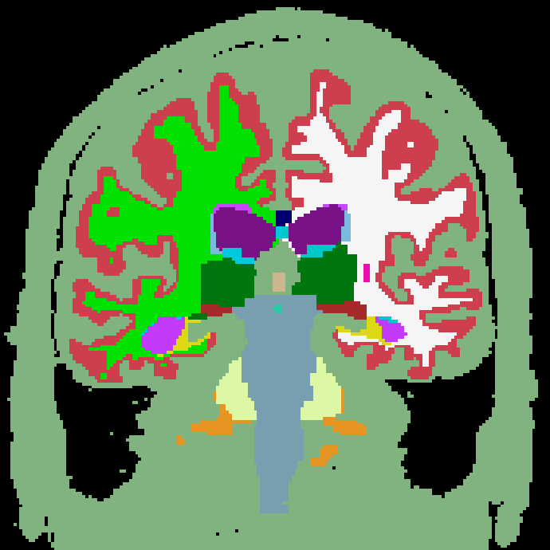
Brain segmentation in the clinic
MRI
segmentation
Focus: translation into clinical settings!

Slide 11
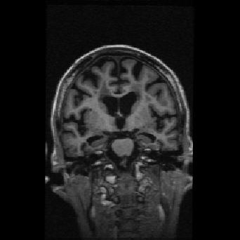
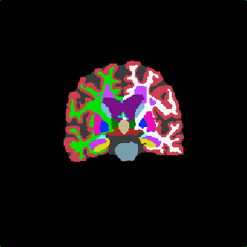
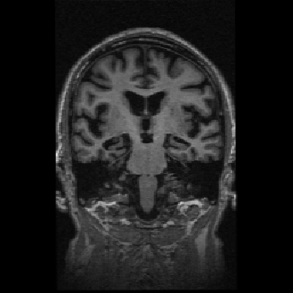
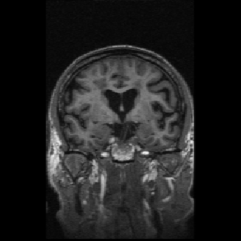
Discriminative methods?
Directly learn to predict segmentation labels from intensities
scan 1
segmentation 1
…
…
…
“Monkey see,
monkey do!”
scan N
segmentation N
Training data

Slide 12

Discriminative methods?
How long to manually label one MRI scan?

Slide 13
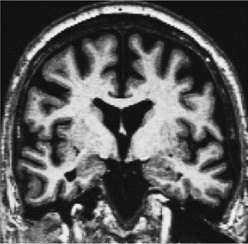
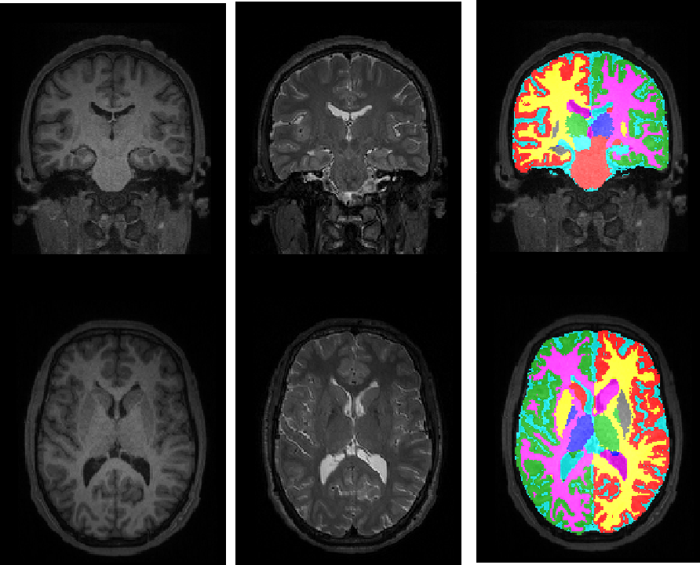
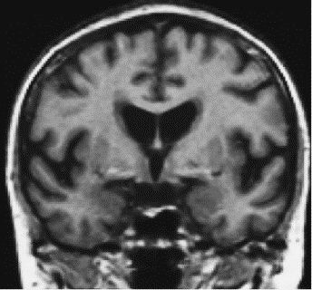
Discriminative methods?
Tissue contrast depends on hardware and pulse sequence
Siemens Vision 1.5T MPRAGE
Siemens Tim Trio 3T MPRAGE
GE Signa 1.5T SPGR

Slide 14
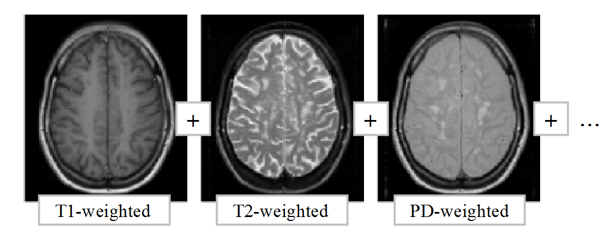
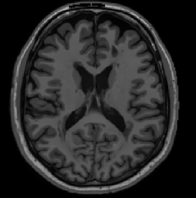
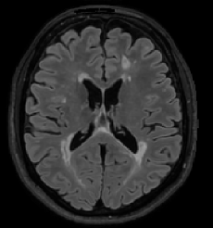
Discriminative methods?
No standard protocol for clinical imaging (multi-contrast)
+
+
…
T1-weighted
FLAIR

Slide 15
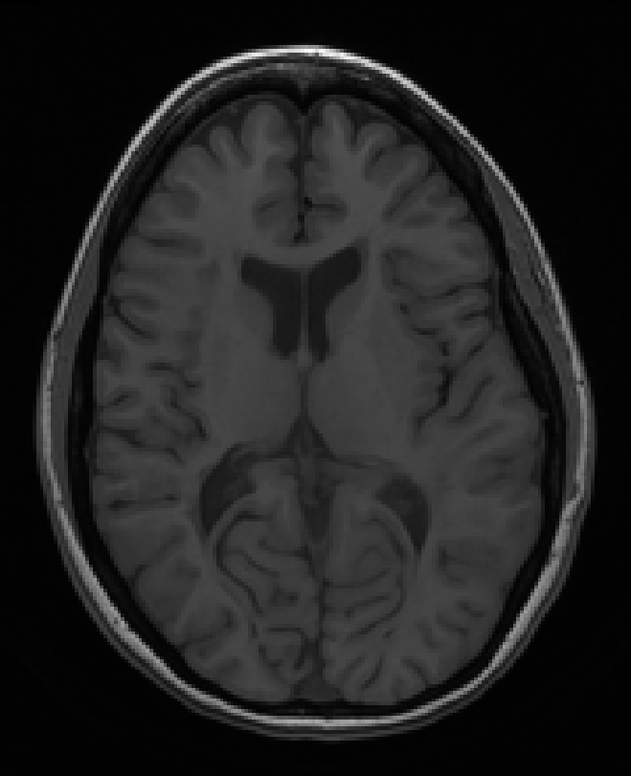
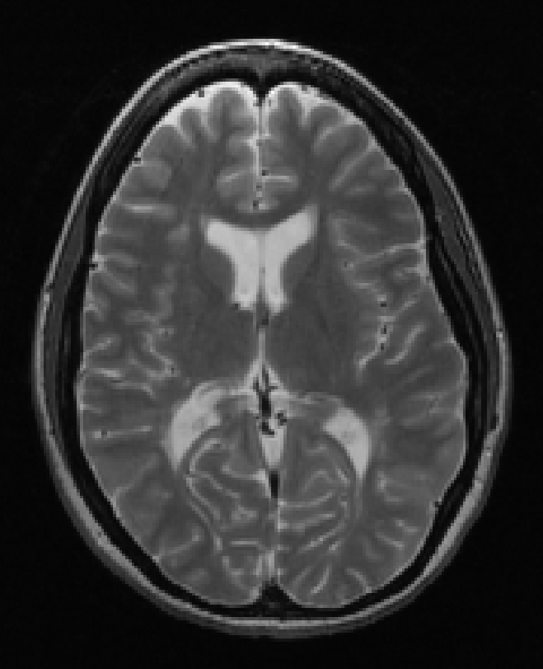
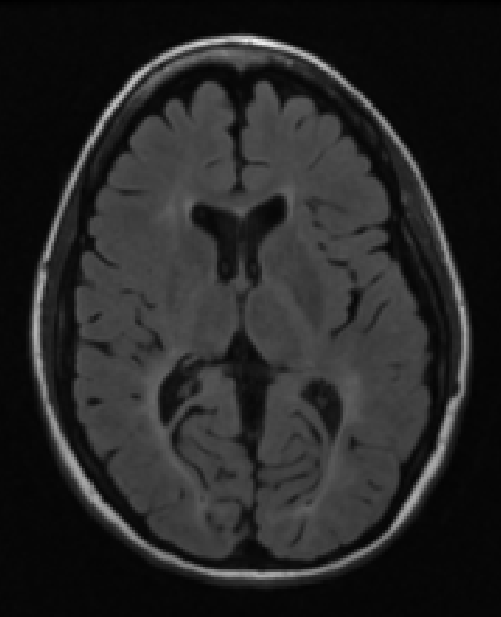
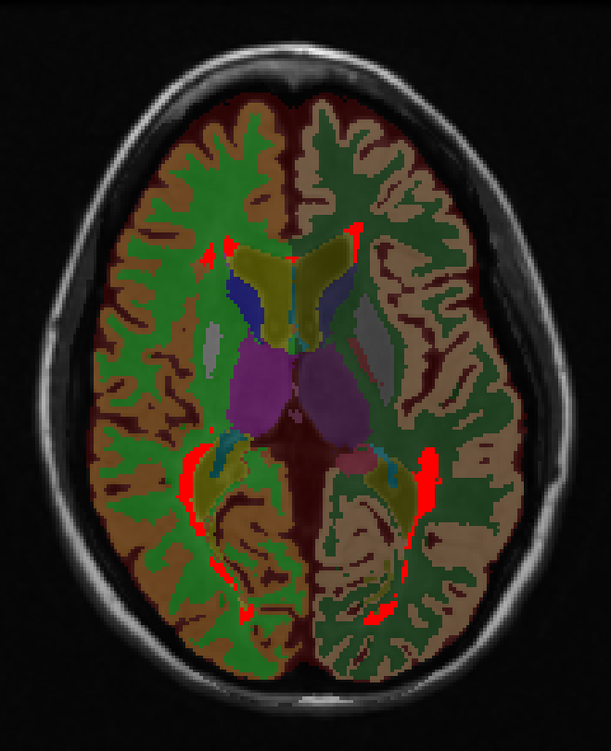
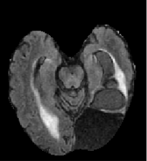
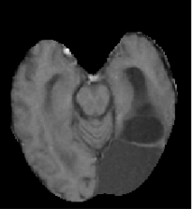
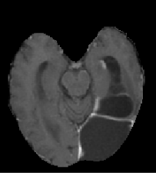
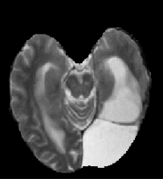
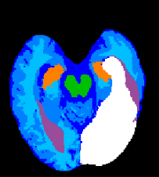
Discriminative methods?
Many different brain diseases
T1w
T2w
FLAIR
FLAIR
T1w
T1c
T2w

Slide 16
Generative methods: Gaussian mixture model
Voxel-wise classification: maximize
label (3 classes)
intensity

Slide 17
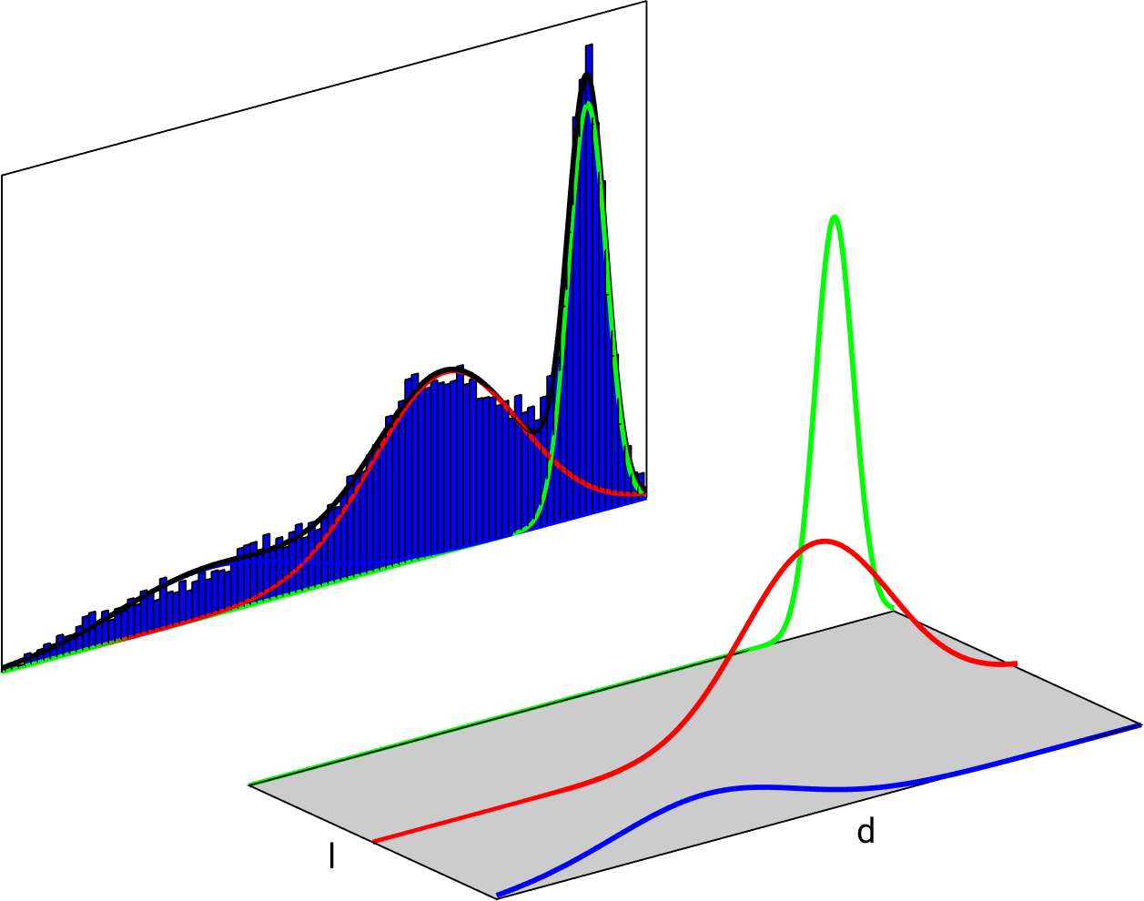
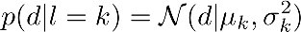
Generative methods: Gaussian mixture model
Voxel-wise classification: maximize
Idea: model the joint distribution instead
label (3 classes)
intensity

Slide 18
Generative methods: Gaussian mixture model
Voxel-wise classification: maximize
Idea: model the joint distribution instead
label (3 classes)
intensity
model parameters

Slide 19
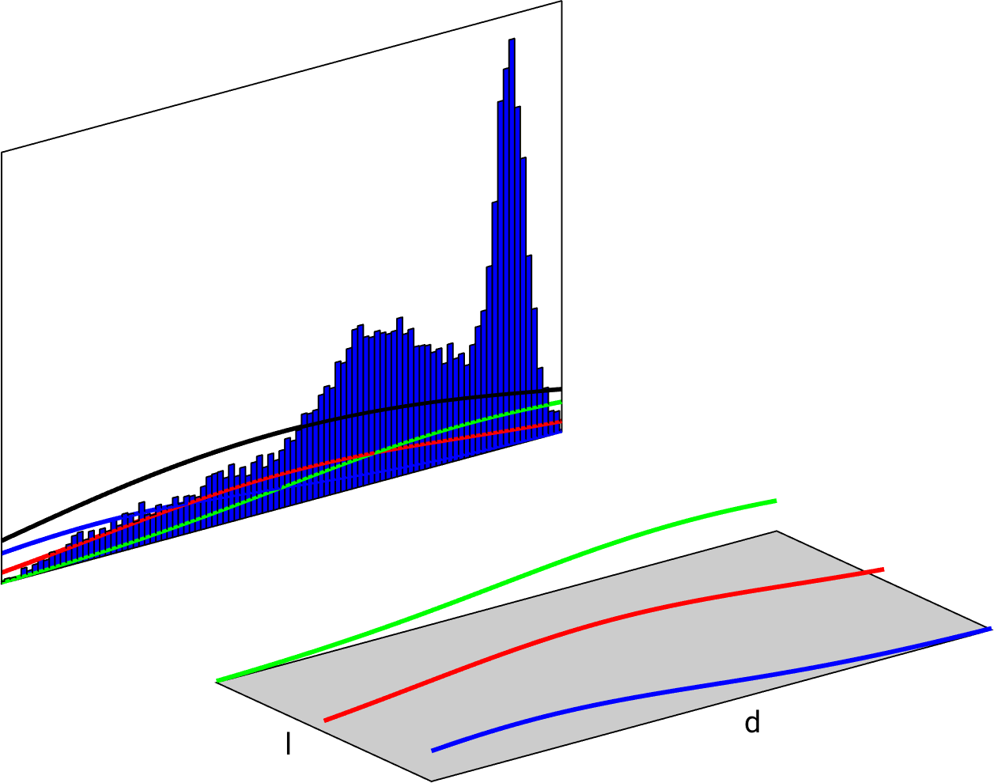
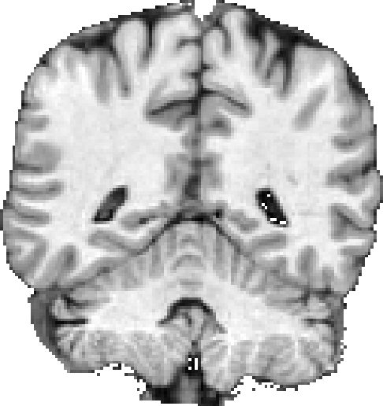
Generative methods: Gaussian mixture model

Slide 20
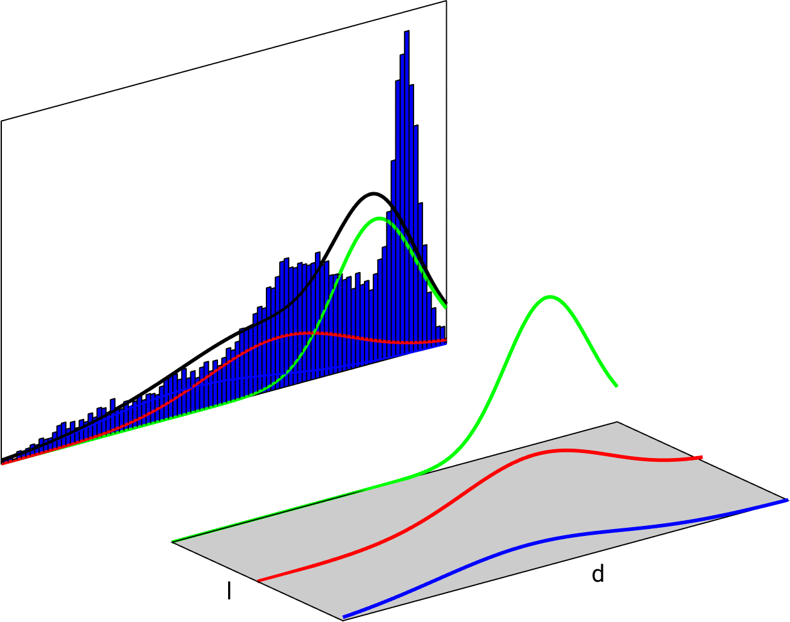
Generative methods: Gaussian mixture model

Slide 21
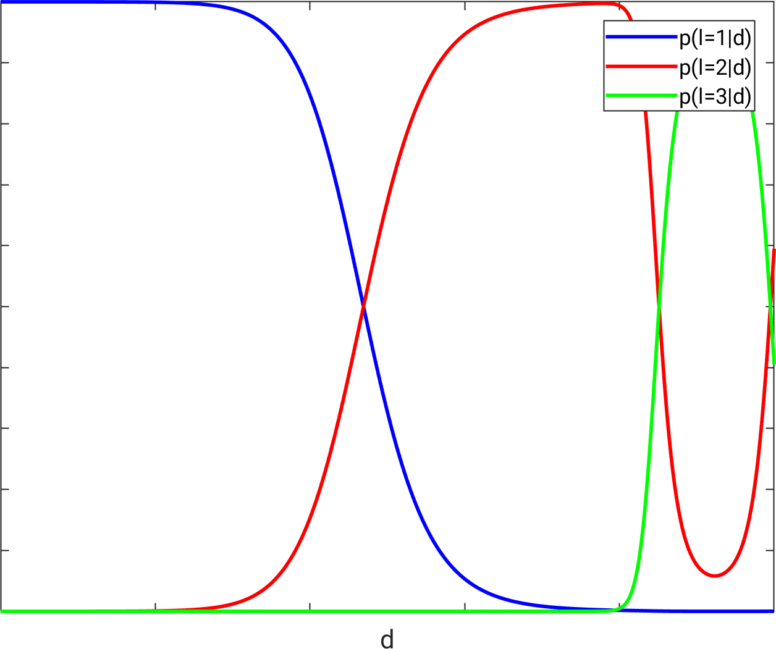
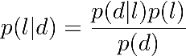
Generative methods: Gaussian mixture model

Slide 22
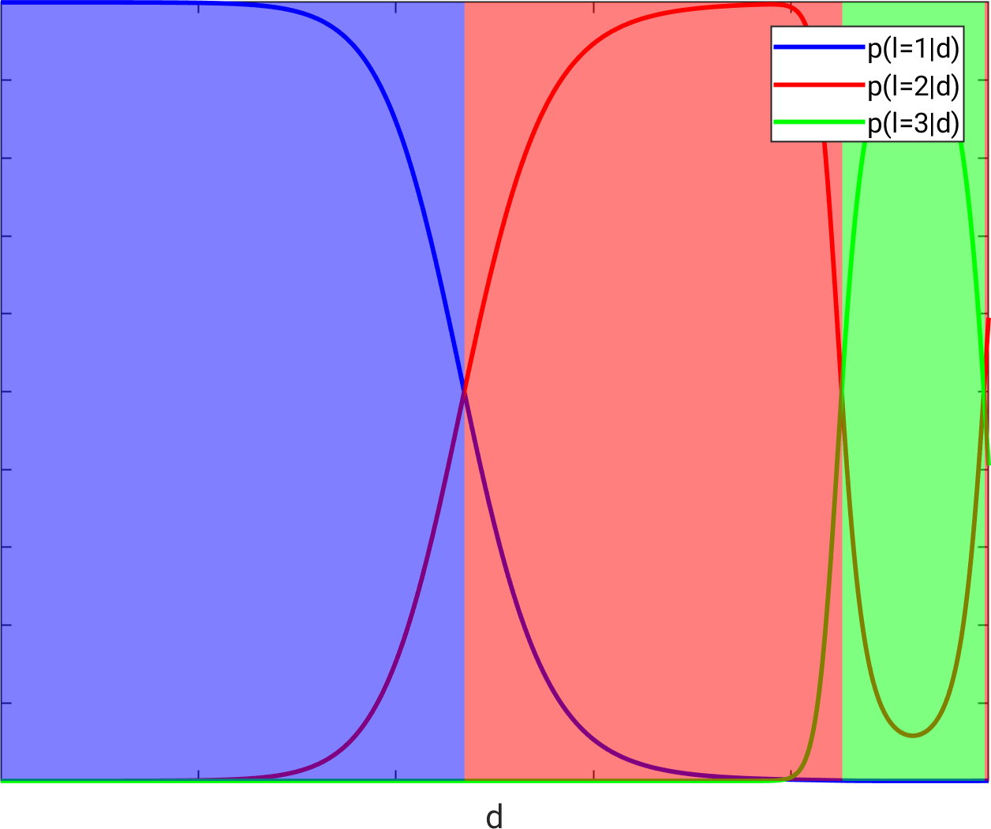
Generative methods: Gaussian mixture model

Slide 23
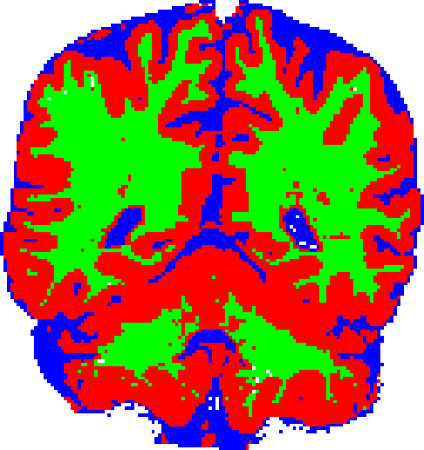
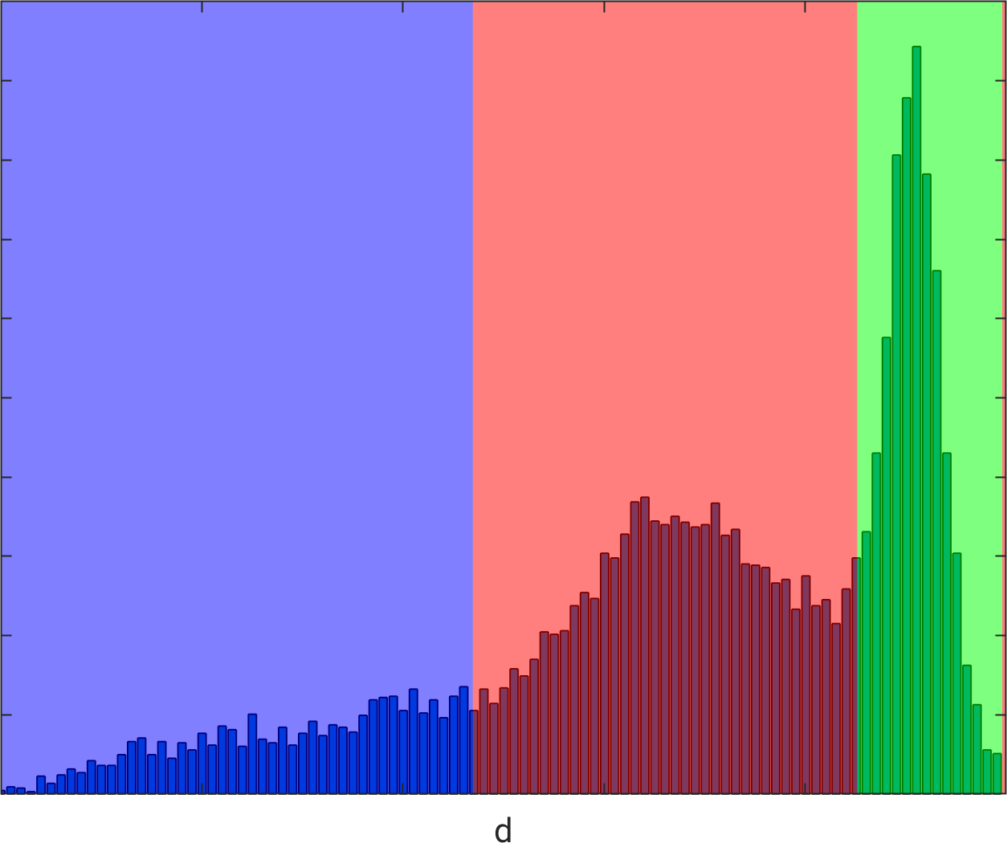
Generative methods: Gaussian mixture model

Slide 24
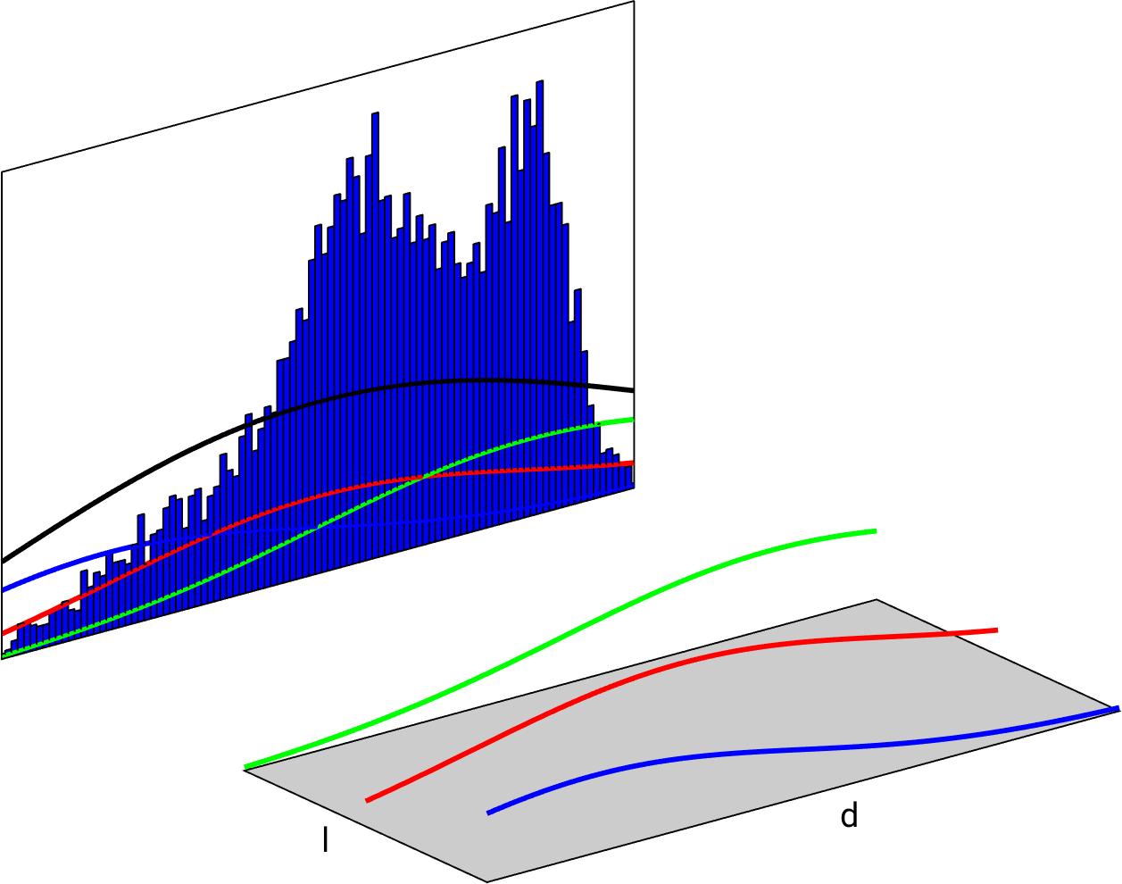
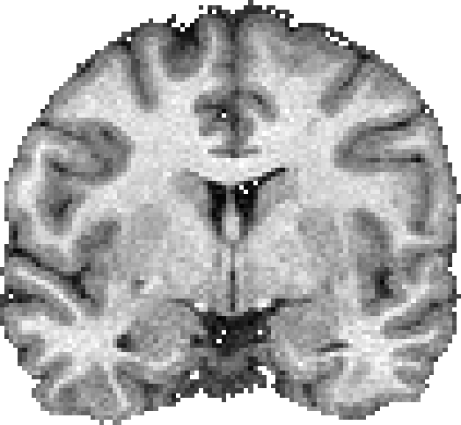
Generative methods: Gaussian mixture model
new subject:
different scanner/protocol

Slide 25

Generative methods: Gaussian mixture model
new subject:
different scanner/protocol

Slide 26
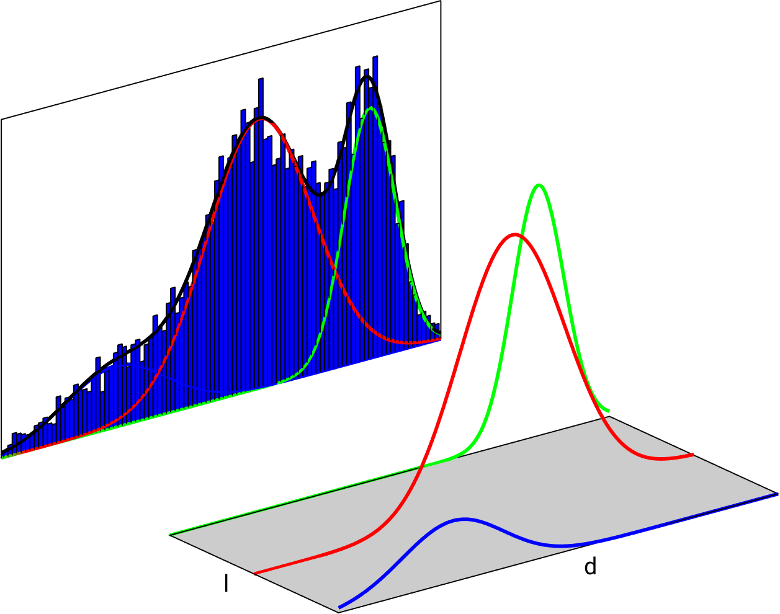
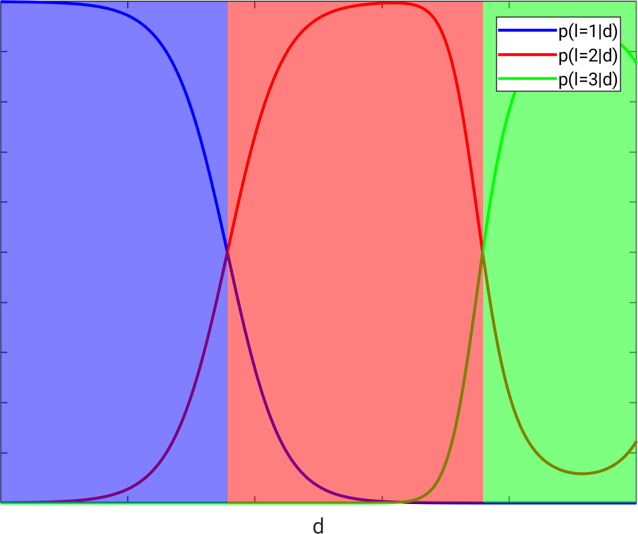
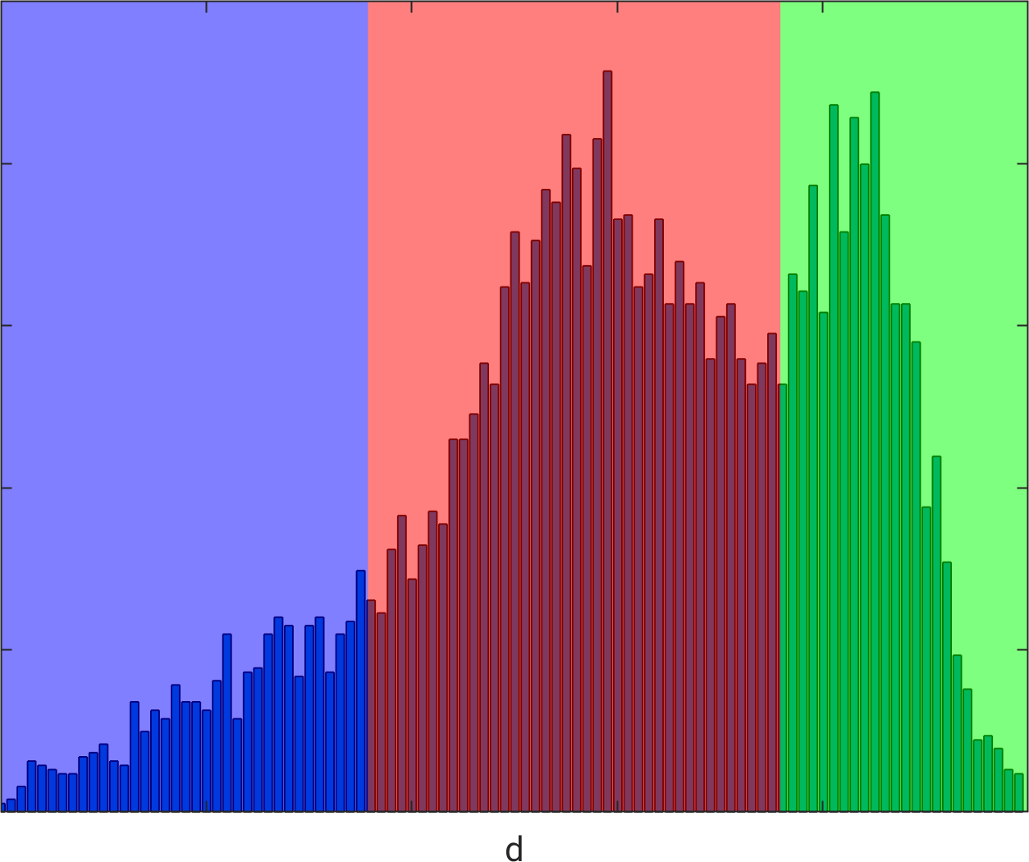
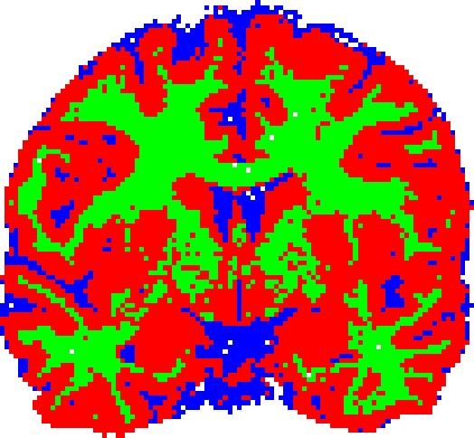
Generative methods: Gaussian mixture model
new subject:
different scanner/protocol

Slide 27


Gaussian mixture model
Adaptive!
No matching training data needed!
Slow because of image-specific optimization
new subject:
different scanner/protocol

Slide 28
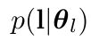
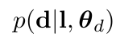
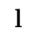
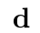
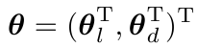
Generative models
A probabilistic model of how an MRI image is formed
The model depends on some parameters
Appropriate values can be estimated
“anatomical model”
“imaging model”
Label image
MRI image

Slide 29
Generative models
A probabilistic model of how an MRI image is formed
The model depends on some parameters
Appropriate values can be estimated
“anatomical model”
“imaging model”
Label image
MRI image

Slide 30
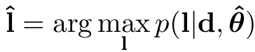
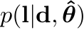

Segmentation = inverse problem
MRI image
Label image
The posterior distribution is given by Bayes rule:

Slide 31
Segmentation = inverse problem
MRI image
Label image
The posterior distribution is given by Bayes rule:
imaging model
anatomical model

Slide 32



Gaussian mixture model
“anatomical model”
“imaging model”
Label image
MRI image
You can’t segment 40+ brain structures with this…

Slide 33



Anatomical model
“anatomical model”
“imaging model”
Label image
MRI image
The parameters are the location of mesh nodes in an atlas
Deformation prior
[Van Leemput TMI 2009]

Slide 34


Imaging model
“anatomical model”
“imaging model”
Label image
MRI image
+
Gaussian mixture model
parametric bias field model

Slide 35


“Inverting” the model
http://freesurfer.net/
~10min (CPU)
1.5T T1-weighted scans
with manual delineations
(20 subjects)
Training data
[Puonti, NeuroImage 2016]
3T multi-contrast scan

Slide 36
Adding pathology into the mix…
Tissue contrast depends on hardware and pulse sequence
No standard protocol for clinical imaging (multimodal)
Additional difficulty: Disease-specific lesions!
Lesion

Slide 37

Idea: alter the generative model
“anatomical model”
“imaging model”
Label image
MRI image
Use two anatomical models that are trained on different subjects!
+

Slide 38



Radiation therapy planning
Radiate a brain tumor while sparing organs-at-risk
Need to know where these structures are
eyes
hippocampus
Optic nerve/chiasm
tumor
brainstem

Slide 39


[Agn et al., Medical Image Analysis 2019]
Radiation therapy planning

Slide 40
[Agn et al., Medical Image Analysis 2019]
Radiation therapy planning

Slide 41
[Agn et al., Medical Image Analysis 2019]
Radiation therapy planning

Slide 42






Tiny brain structures
http://freesurfer.net/
[Iglesias NeuroImage 2015]
hippocampus
[Saygin NeuroImage 2017]
amygdala
[Iglesias NeuroImage 2018]
thalamus

Slide 43



Segmentation method same as before
amygdala
hippocampus
thalamus

Slide 44




Discriminative methods?
in vivo 1mm isotropic
ex vivo 0.13mm isotropic
ex vivo expert segmentation
Manual delineations on high-resolution ex vivo scans:
Intrinsic MRI contrast changes
Only ~10 training subjects

Slide 45

[Iglesias et al., NeuroImage 2015]
T1w only (1mm isotropic)

Slide 46



[Iglesias et al., NeuroImage 2015]
T1w only (1mm isotropic)
Additional T2w (0.38 x 0.38 x 0.8 mm)

Slide 47
Overview
Uncertainty on input using generative models
Uncertainty on output using Monte Carlo sampling
Discussion and conclusion

Slide 48
Uncertainty papers from me/my group…
variational approximation
Mean-field approximation of MRFs (TMI 1999)
Metropolis sampling for partial volume models (TMI 2003)
HMC for visualizing atlas warp priors (TMI 2009)
HMC + Gibbs sampling for segmentation uncertainty (MEDIA 2013)
Gibbs sampling for analyzing STAPLE (MICCAI 2014)
HMC for PET reconstruction uncertainty (MICCAI 2015)
Gibbs sampling for radiotherapy segmentations (MEDIA 2019)
Gibbs sampling for MI-based registration uncertainty (UNSURE 2019)
Monte Carlo sampling

Slide 49



Monte Carlo (MC) sampling
Obtain samples of :
Samples from marginal distributions are obtained automatically
Integrals over nuisance variables automagically “disappear”!
Approximate expectations:

Slide 50




Why Monte Carlo sampling?
Variational methods (mean-field approximation):
Minimize the Kullback-Leibler divergence between and
≈
x
=

Slide 51



Variational approximations (mean-field)?
Registration uncertainty [Le Folgoc TMI 2017]
Fast
Can be hugely inaccurate (for strong dependencies)
No red flags raised
[Bishop PRML 2016]
Monte Carlo
variational
- OK for increasing e.g., Dice scores
- Dubious for anything else

Slide 52


BTW: dropout at test time?
Randomly remove some units in a neural network [Gal & Ghahramani ICML 2016]
Popular in medical image analysis
≈
x
=
Really?

Slide 53



Monte Carlo sampling in high dimensions
Markov chain Monte Carlo (MCMC):
Propose a perturbation of a current state using a proposal distribution
Accept with probability
[Metropolis-Hastings]

Slide 54

Monte Carlo sampling in high dimensions
Markov chain Monte Carlo (MCMC):
Propose a perturbation of a current state using a proposal distribution
Accept with probability
[Metropolis-Hastings]

Slide 55

Monte Carlo sampling in high dimensions
Markov chain Monte Carlo (MCMC):
Propose a perturbation of a current state using a proposal distribution
Accept with probability
[Metropolis-Hastings]

Slide 56

Monte Carlo sampling in high dimensions
Markov chain Monte Carlo (MCMC):
Propose a perturbation of a current state using a proposal distribution
Accept with probability
[Metropolis-Hastings]

Slide 57

Monte Carlo sampling in high dimensions
Markov chain Monte Carlo (MCMC):
Propose a perturbation of a current state using a proposal distribution
Accept with probability
[Metropolis-Hastings]

Slide 58

Monte Carlo sampling in high dimensions
Markov chain Monte Carlo (MCMC):
Propose a perturbation of a current state using a proposal distribution
Accept with probability
[Metropolis-Hastings]

Slide 59
Monte Carlo sampling in high dimensions
Markov chain Monte Carlo (MCMC):
Propose a perturbation of a current state using a proposal distribution
Accept with probability
[Metropolis-Hastings]
- Great approximations
- Dependencies can make things
super slow
- Burn-in period?

Slide 60



Gibbs sampling
Proposal distributions are conditional distributions:
Proposals always accepted
No tuning needed!
Cf. optimization:
Coordinate descent
EM algorithm (95% same code!)

Slide 61

Gibbs sampling
Proposal distributions are conditional distributions:
Proposals always accepted
No tuning needed!
Cf. optimization:
Coordinate descent
EM algorithm (95% same code!)

Slide 62

Gibbs sampling
Proposal distributions are conditional distributions:
Proposals always accepted
No tuning needed!
Cf. optimization:
Coordinate descent
EM algorithm (95% same code!)

Slide 63

Gibbs sampling
Proposal distributions are conditional distributions:
Proposals always accepted
No tuning needed!
Cf. optimization:
Coordinate descent
EM algorithm (95% same code!)

Slide 64






Gibbs sampling: Gaussian mixture model
Sampling from
sample from but only keep samples of

Slide 65




Gibbs sampling: radiation therapy application
Optimization as initialization
Then Gibbs sampling from everything except atlas warp
(segmentation – bias field – Gaussian mixture parameters – latent shape model parameters)
[Agn et al., Medical Image Analysis 2019]

Slide 66



Gibbs sampling: MI-based registration
Mutual Information (MI) rephrased as a generative model
EM optimization as initialization, then Gibbs sampling (code re-use!)
T2w
T1w different subject
deformed T2w (samples)
[Agn and Van Leemput, UNSURE 2019]

Slide 67




Hamiltonian Monte Carlo (HMC)
Introduce virtual “momentum” variables
Sample from , and ignore momentum samples

Slide 68

Hamiltonian Monte Carlo (HMC)
(1) Sample momentum
from
(2) Follow isocontour of
(3) Repeat (1) and (2)
Efficiency by using gradient information
Cf. optimization

Slide 69

Hamiltonian Monte Carlo (HMC)
(1) Sample momentum
from
(2) Follow isocontour of
(3) Repeat (1) and (2)
Efficiency by using gradient information
Cf. optimization

Slide 70

Hamiltonian Monte Carlo (HMC)
(1) Sample momentum
from
(2) Follow isocontour of
(3) Repeat (1) and (2)
Efficiency by using gradient information
Cf. optimization

Slide 71

Hamiltonian Monte Carlo (HMC)
(1) Sample momentum
from
(2) Follow isocontour of
(3) Repeat (1) and (2)
Efficiency by using gradient information
Cf. optimization

Slide 72

Hamiltonian Monte Carlo (HMC)
(1) Sample momentum
from
(2) Follow isocontour of
(3) Repeat (1) and (2)
Efficiency by using gradient information
Cf. optimization

Slide 73

Hamiltonian Monte Carlo (HMC)
(1) Sample momentum
from
(2) Follow isocontour of
(3) Repeat (1) and (2)
Efficiency by using gradient information
Cf. optimization

Slide 74

HMC: hippocampal subfield segmentation
0.38 x 0.38 x 0.8 mm³

Slide 75

HMC: hippocampal subfield segmentation
0.38 x 0.38 x 0.8 mm³

Slide 76


HMC: hippocampal subfield segmentation
0.38 x 0.38 x 0.8 mm³
mesh node positions;
Gaussian means and variances

Slide 77

HMC: hippocampal subfield segmentation
0.38 x 0.38 x 0.8 mm³
mesh node positions;
Gaussian means and variances

Slide 78


HMC: hippocampal subfield segmentation
0.38 x 0.38 x 0.8 mm³

Slide 79
HMC: hippocampal subfield segmentation
0.38 x 0.38 x 0.8 mm³

Slide 80


HMC: hippocampal subfield segmentation
Sample from by sampling from
HMC for atlas deformation; Gibbs sampling for the rest
1x1x1 mm³
[Iglesias et al., Medical Image Analysis 2013]

Slide 81





Uncertainty of
Uncertainty of
Samples from
[Iglesias et al., Medical Image Analysis 2013]

Slide 82


HMC: hippocampal subfield segmentation
Volumes of the subfields:
Better “error bars”
2% boost in classification accuracy AD vs. controls
[Iglesias et al., Medical Image Analysis 2013]

Slide 83


HMC: PET reconstruction
[Pedemonte and Van Leemput, MICCAI 2015]
Reconstruction = inverting a generative model
HMC:
chosen “wisely” (using FFTs)
projection data
reconstruction samples

Slide 84

HMC: PET reconstruction
[Pedemonte and Van Leemput, MICCAI 2015]
Reconstruction = inverting a generative model
HMC:
chosen “wisely” (using FFTs)

Slide 85
Overview
Uncertainty on input using generative models
Uncertainty on output using Monte Carlo sampling
Discussion and conclusion

Slide 86
Discussion and Conclusion
Generative models in addition to discriminative models
Monte Carlo sampling in addition to variational approximations
prediction
uncertainty on input
Main drawback is computational speed, but sometimes it’s worth it
uncertainty on output
input variation
intensity

Slide 87





Acknowledgements
We’re hiring!
(postdoc in Boston)
Laboratory for Computational Neuroimaging
Eugenio Iglesias
Oula Puonti
Mikael Agn
Stefano Pedemonte

